Slide 1
AWAKENINGS
Vinson Synan
January 14, 2016
Founders Inn

Slide 2
EPHESIANS 5:14
Awake, you who sleep, Arise from the dead. And Christ will give you light.

Slide 3
II Chronicles 7:14
If my people who are called by My name will humble themselves, and pray and seek my face, and turn from their wicked ways, then I will hear from heaven, and will forgive their sin and heal their land.

Slide 4
THE FIRST GREAT AWAKENING
1740-1765
NORTHAMPTON CHURCH
NEW ENGLAND

Slide 5
Jonathan Edwards (1703-58)
This nearly expression-less portrait of Jonathan Edwards fails to suggest his passion for God
and only hints at the surpassing range
of his intellect.
(Portrait at the Library of Congress)
A PASTOR

Slide 6
George Whitefield (1714-70)
GREATEST EVANGELIST
OF HIS DAY

Slide 7
Charles Chauncy (1705-1787)
Chauncy was known as “Old Brick”, and he strongly opposed the Great Awakening. He gained the reputation as an erudite but dull preacher of orthodoxy. However, the Awakening caused him concern about the emotional excesses in some quarters of the revival.
His work, Seasonable Thoughts on the State
of Religion in New-England (1743) catalogued what he thought were the revival’s
worst manifestations. He eventually
became a universalist.

Slide 8
THE SECOND GREAT AWAKENING
KENTUCKY
1800-1830

Slide 9
Cane Ridge Meeting house
Bourbon County, Kentucky
Largest and most famous camp meeting of the Second Great Awakening. The revival scene that took place during August 1801 defies objective description. Some have considered it the greatest outpouring of the Holy Spirit since Pentecost.

Slide 10
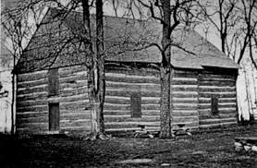
CANE RIDGE MEETING HOUSE

Slide 11
Barton W. Stone
(1772-1844)
Barton W. Stone
Stone was one of the founders of the Disciples of Christ. He preached from 1801-03 at Cane Ridge, Kentucky (near Paris, KY), a center of America’s “Second Great Awakening.” In 1803 he and four colleagues left the Presbyterian Synod of Kentucky and formed a new group. They avoided the use of any word other than “Christian” in naming their churches. In the 1820s Stone joined with Alexander Campbell and formed the Christian Church (Disciples of Christ).
A Pastor

Slide 12
Alexander Campbell
(1788-1866)
ALEXANDER CAMPBELL
Founder of the Disciples of Christ, He was opposed to creeds and to revivalistic excesses and founded Bethany College. His managerial ability and his scientific farming methods brought him wealth, and his home became a public attraction.

Slide 13
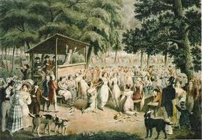
CANE RIDGE CAMP MEETING

Slide 14
THIRD GREAT AWAKENING
1858
New York
Called the Layman’s Revival
Fulton street church
Jeremiah Lanpher, Pastor
10,000 businessmen - daily prayer
2000 mile revival – NYC to Omaha

Slide 15
FOURTH GREAT AWAKENING
AZUSA STREET
1906-1909
WILLIAM J. SEYMOUR
A PASTOR

Slide 16
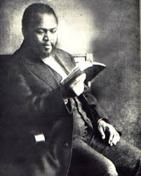
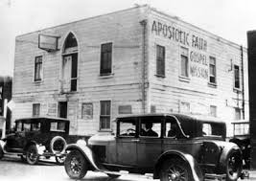
AZUSA STREET
WILLIAM J. SEYMOUR
..

Slide 17
TEACHINGS AT AZUSA STREET
(FIVE- FOLD GOSPEL)
1. Salvation (Evangelical Conversion)
2. Sanctification (Wesleyan View)
3. Baptism In The Holy Spirit With Tongues
As “Initial Evidence”
4. Divine Healing
5. Imminent Premillennial Second Coming Of Christ

Slide 18
RESULTS OF AZUSA STREET
1,000,000 Churches In The World
625,000,000 Pentecostals And
Charismatics In The World (2015)
Thousands Of Mainline Churches Renewed
Fastest Growing Revival In History

Slide 19
FIFTH GREAT AWAKENING
LED BY EVANGELISTS
USA - 1948-60
Billy Graham
Oral Roberts

Slide 20
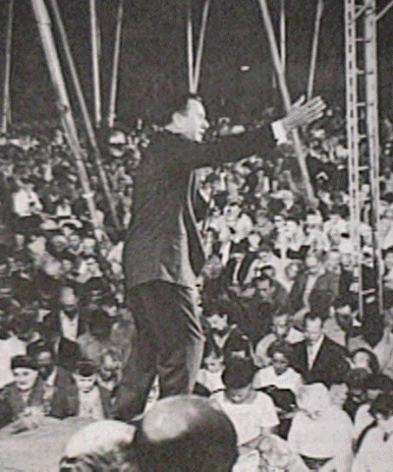
ORAL
ROBERTS
HEALING
CRUSADES

Slide 21
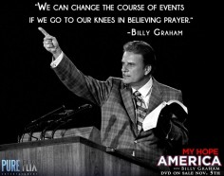

Slide 22
THE JESUS PEOPLE
1970’S
Hippies And Drug Addicts
Coffee Houses
Started In California
Holy Spirit Led
Pastor Chuck Smith Helped Steer Awakening

Slide 23
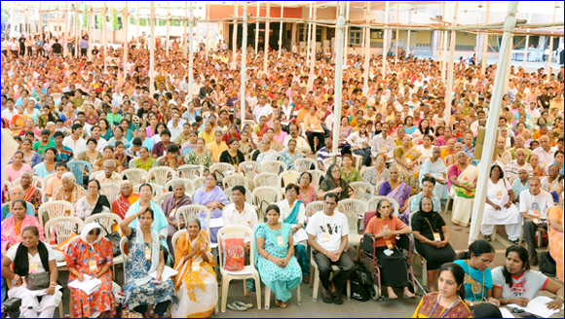
THE CATHOLIC CHARISMATIC MOVEMENT
IN THE ROMAN CATHOLIC CHURCH,
LED BY LAYMEN, BEGAN IN 1967
180,000,000 In The World Today

Slide 24
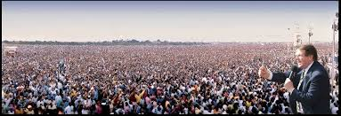
REINHARD BONNKE
GERMAN PENTECOSTAL EVANGELIST

Slide 25
MILLENNIAL CRUSADE 2000
LAGOS, NIGERIA
1,500,000 ATTENDED SERVICE
1,093, 000 CONVERTED IN ONE SERVICE

Slide 26
WHY AMERICA NEEDS AN AWAKENING NOW
National Sins
Loss Of Faith
Declining Church Attendance
Less Bible Reading
Sermon Series That Do Not Confront Sin
Rise Of Other Religions (Islam)

